Slide 1
Learning intentions and success criteria
I am learning…
I can…
About audio hardware
What different audio devices are used for
Describe different types of audio hardware
Identify key features of audio devices

Slide 2

Audio Hardware
NPA Digital Media (Level 5)

Slide 3
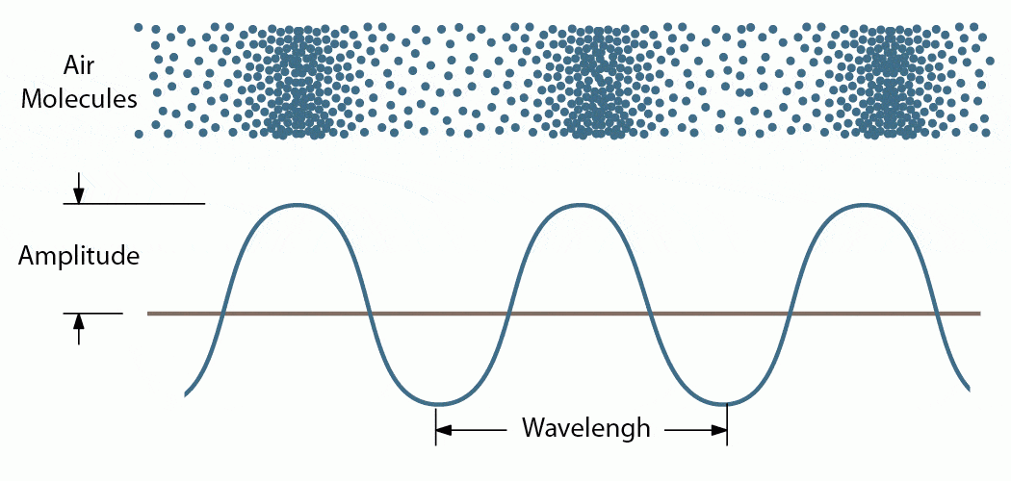
What is Sound?
Sound is a form of energy created by travelling vibrations:
Your ears convert these vibrations into signals that your brain perceives as sound
When travelling through air, the vibrations push and pull the air molecules (like a slinky)

Slide 4
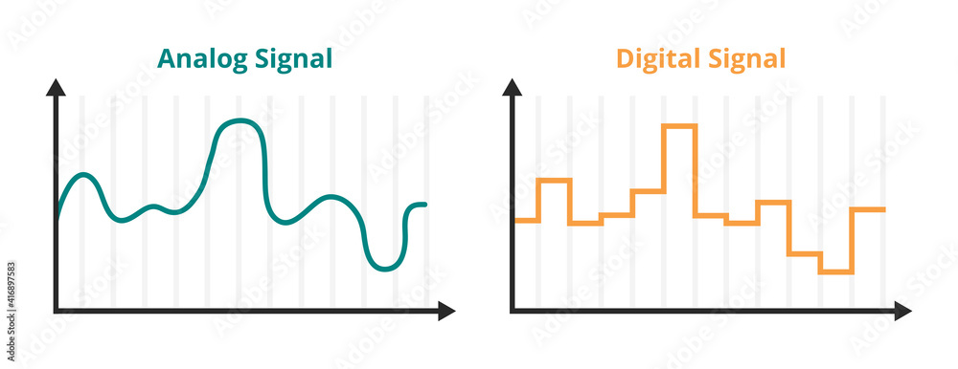
Digital Sound
Using technology, we can capture sound and store it as computer data:
The analog wave can be captured by a microphone
The wave is sampled – the wave is measured at regular intervals

Slide 5
Digital Sound
The measurements of the sound wave are converted to binary values:
Like a staircase – you can step up or step down
An audio file is just a list of these steps – to reproduce the wave approximately

Slide 6
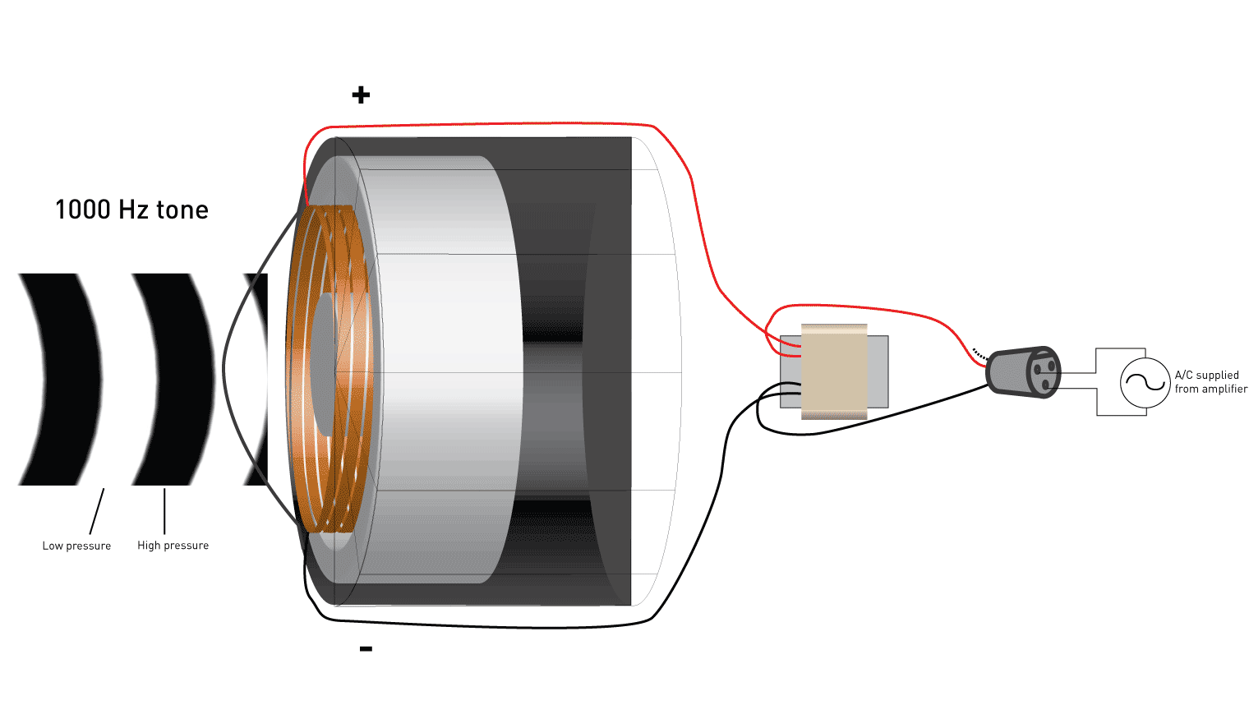
How Microphones work
Sound is created when something vibrates:
These vibrations travel through the air
A micro phone contains a magnet which captures these vibrations which can be converted to a digital signal

Slide 7
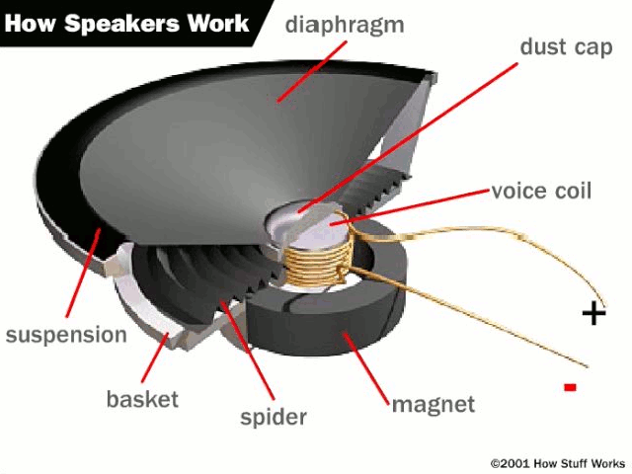
How Speakers work
A speaker takes a digital signal and converts it to vibrations:
Digital audio data is received – the wave data
This is converted to physical movements in the speaker (pushing and pulling)

Slide 8
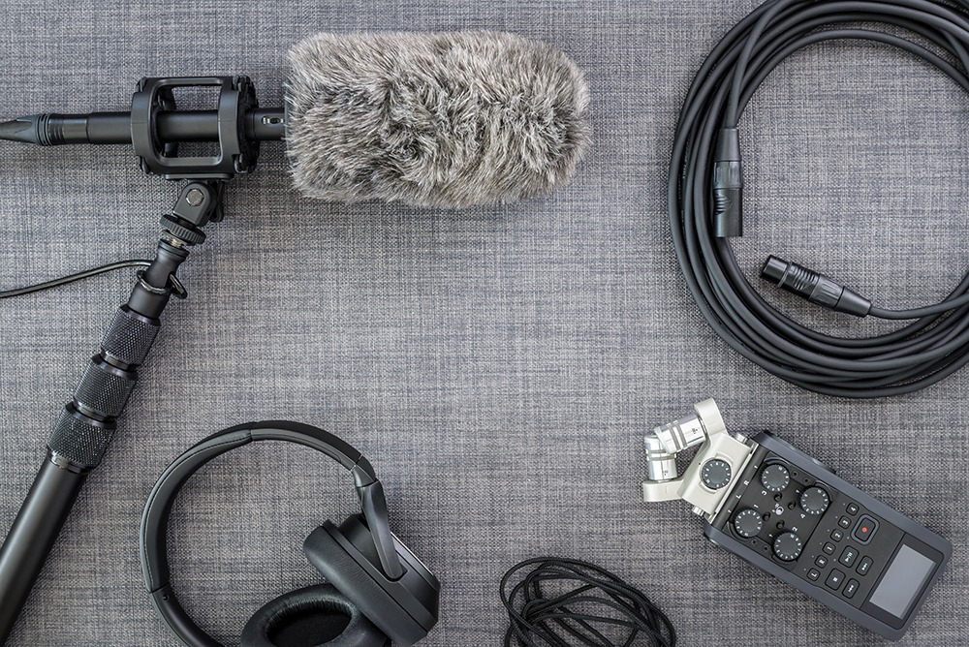
Other Audio hardware
Other audio devices include:
Headphones
Audio cables
Mixing desks
Soundproofing foam
Synthesizers

Slide 9
Learning intentions and success criteria
I am learning…
I can…
About audio hardware
What different audio devices are used for
Describe different types of audio hardware
Identify key features of audio devices

